Slide 1
Chapter 4 Filtering in the Frequency Domain
(overview)

Slide 2


2D DFT
Forward Transform
Inverse Transform

Slide 5



Slide 6
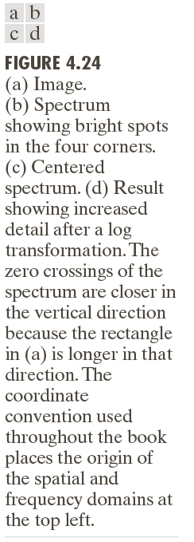
2D DFT

Slide 7
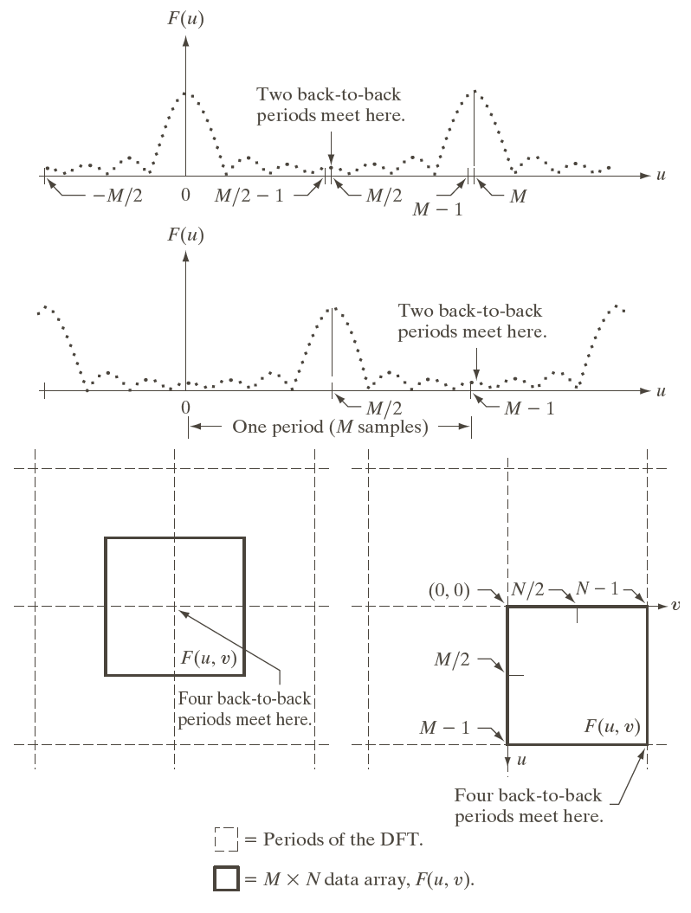

Slide 8
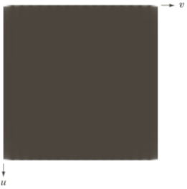
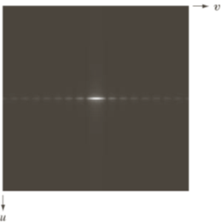

FFT Shift(Exchange Diagonal Sub Matrix) Periodicity of DFT
A | B
C | D
D | C
B | A
A | B
C | D
FFT Shift
FFT Shift

Slide 9


Slide 10






Slide 11


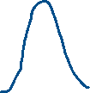

Slide 12








Slide 13




Slide 15
Separability
How many number of multiplications and additions required to implement the 2D –DFT?

Slide 16
Separability

Slide 17




Slide 18



Computing IDFT using DFT Algorithm (conjugate)

Slide 19
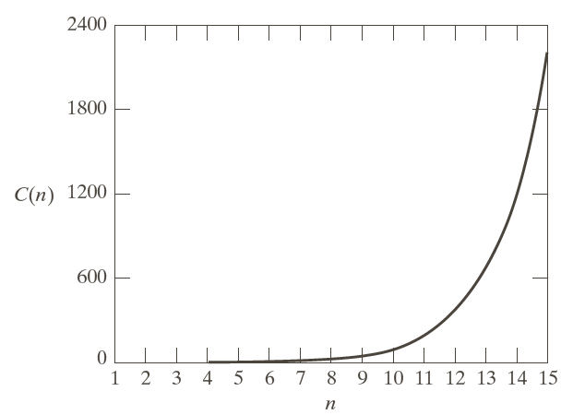
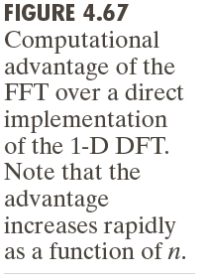
1D DFT & 1D FFT

Slide 22
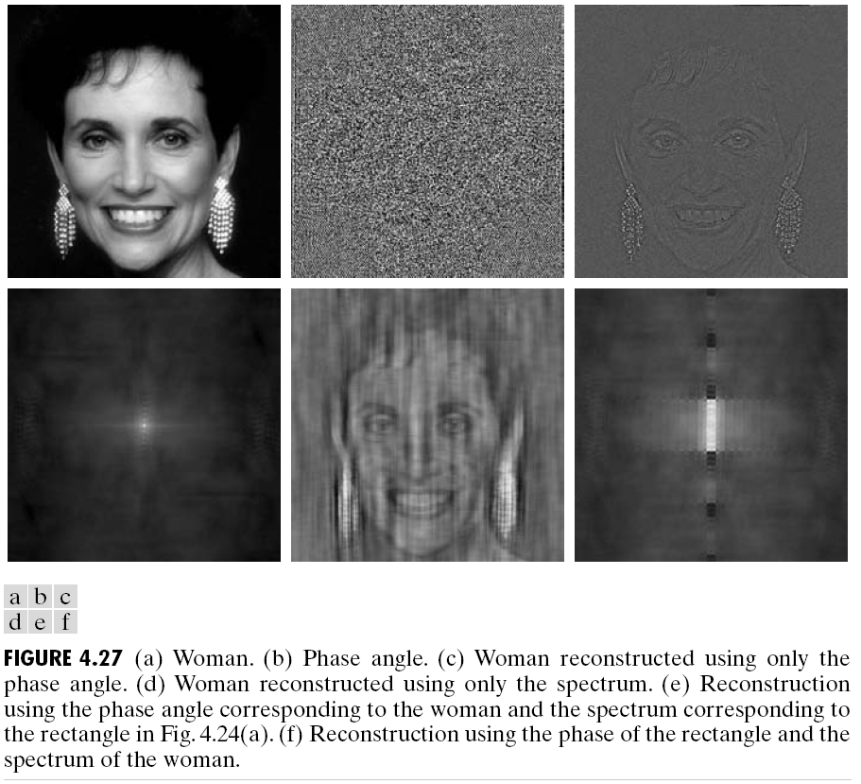
Phase Angle & Shape Information

Slide 23







Slide 24
G(u,v) = F(u,v)H(u,v)
FFT
H(u,v)
G(u,v)
IFFT
g(x,y)
f(x,y)
F(u,v)

Slide 25



Idea Low Pass &Ringing effect

Slide 27
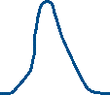
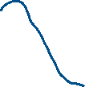


Slide 28

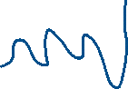

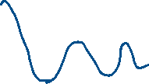

Slide 29
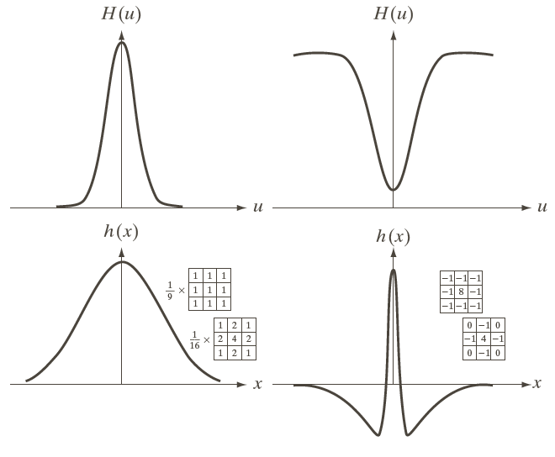
Lowpass & Highpass Filter

Slide 30
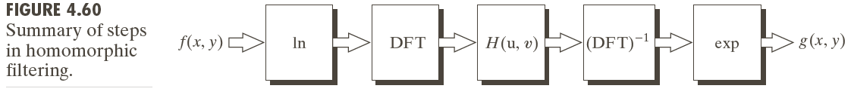
Homomorphic Filtering
f(x,y) = i(x,y)r(x,y)

Slide 31


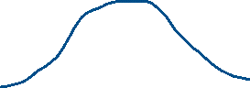

Slide 32
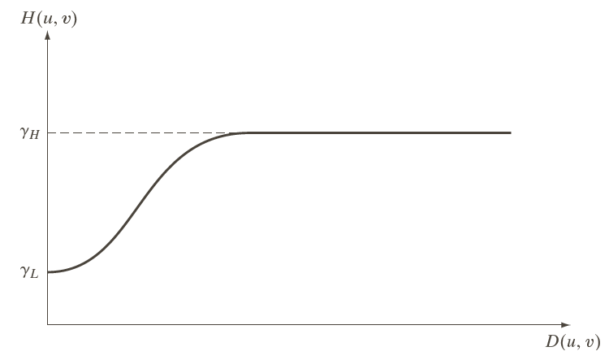
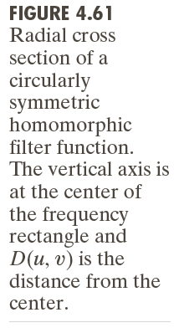
Homomorphic Filtering

Slide 33




Slide 34
Homomorphic Filtering

Slide 35
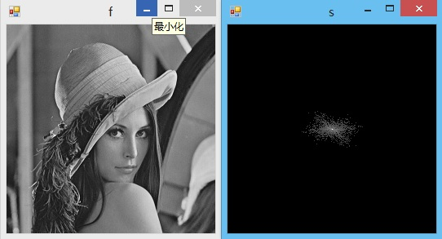
DFT of normal pictures

Slide 36
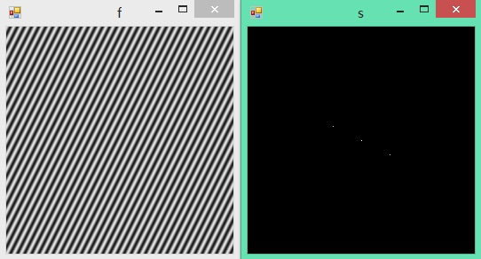
DFT of Sinusoidal functions

Slide 37
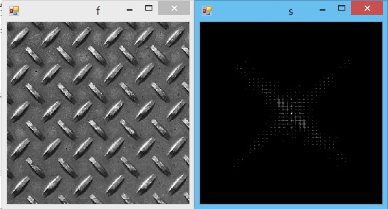
DFT of periodic images

Slide 38
If the signal is periodic, it can be decomposed into a combination of harmonic ones on use of Fourier series.
如果信号是周期性的，其可以分解成傅里叶级数使用的谐波组合。

Slide 39
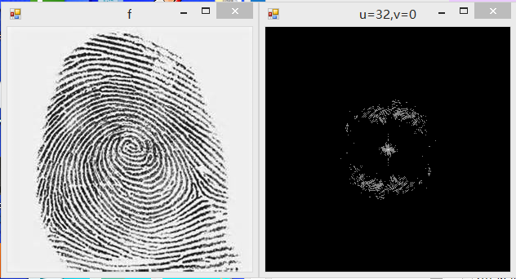
DFT of fingerprint image

Slide 40
Bandreject & Bandpass

Slide 41
Band reject
Band reject

Slide 42
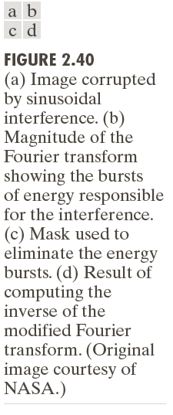
Band reject（sinusoidal Noise）

Slide 43
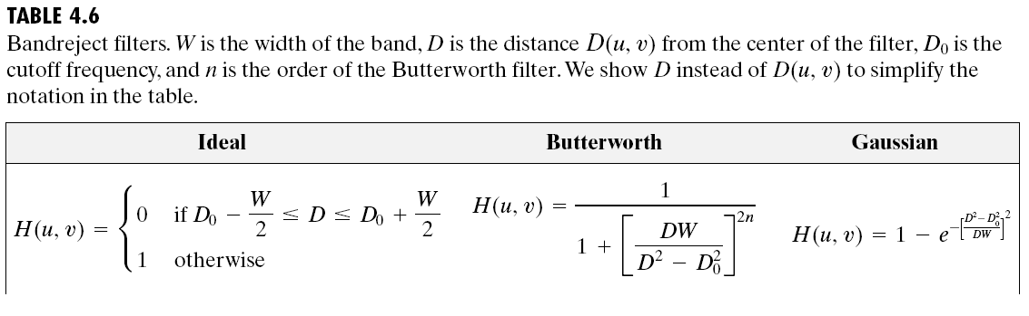
Band reject
[Programming]

Slide 44
Notch Filter
Notch Reject (Demos)
Butterworth Notch Reject
Notch Pass

Slide 45
Notch Filter
[Discuss & Programming]
2013/10/14 ideal np

Slide 46
Notch reject

Slide 47
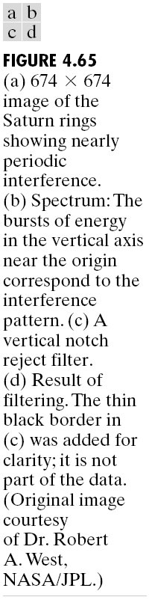
Notch reject

Slide 48
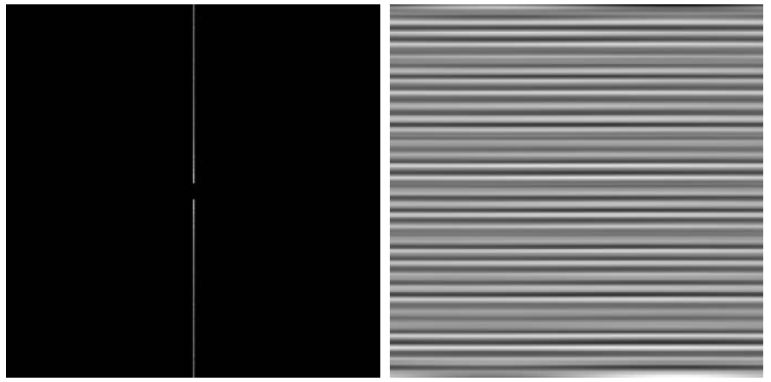
Notch Pass

